Slide 1
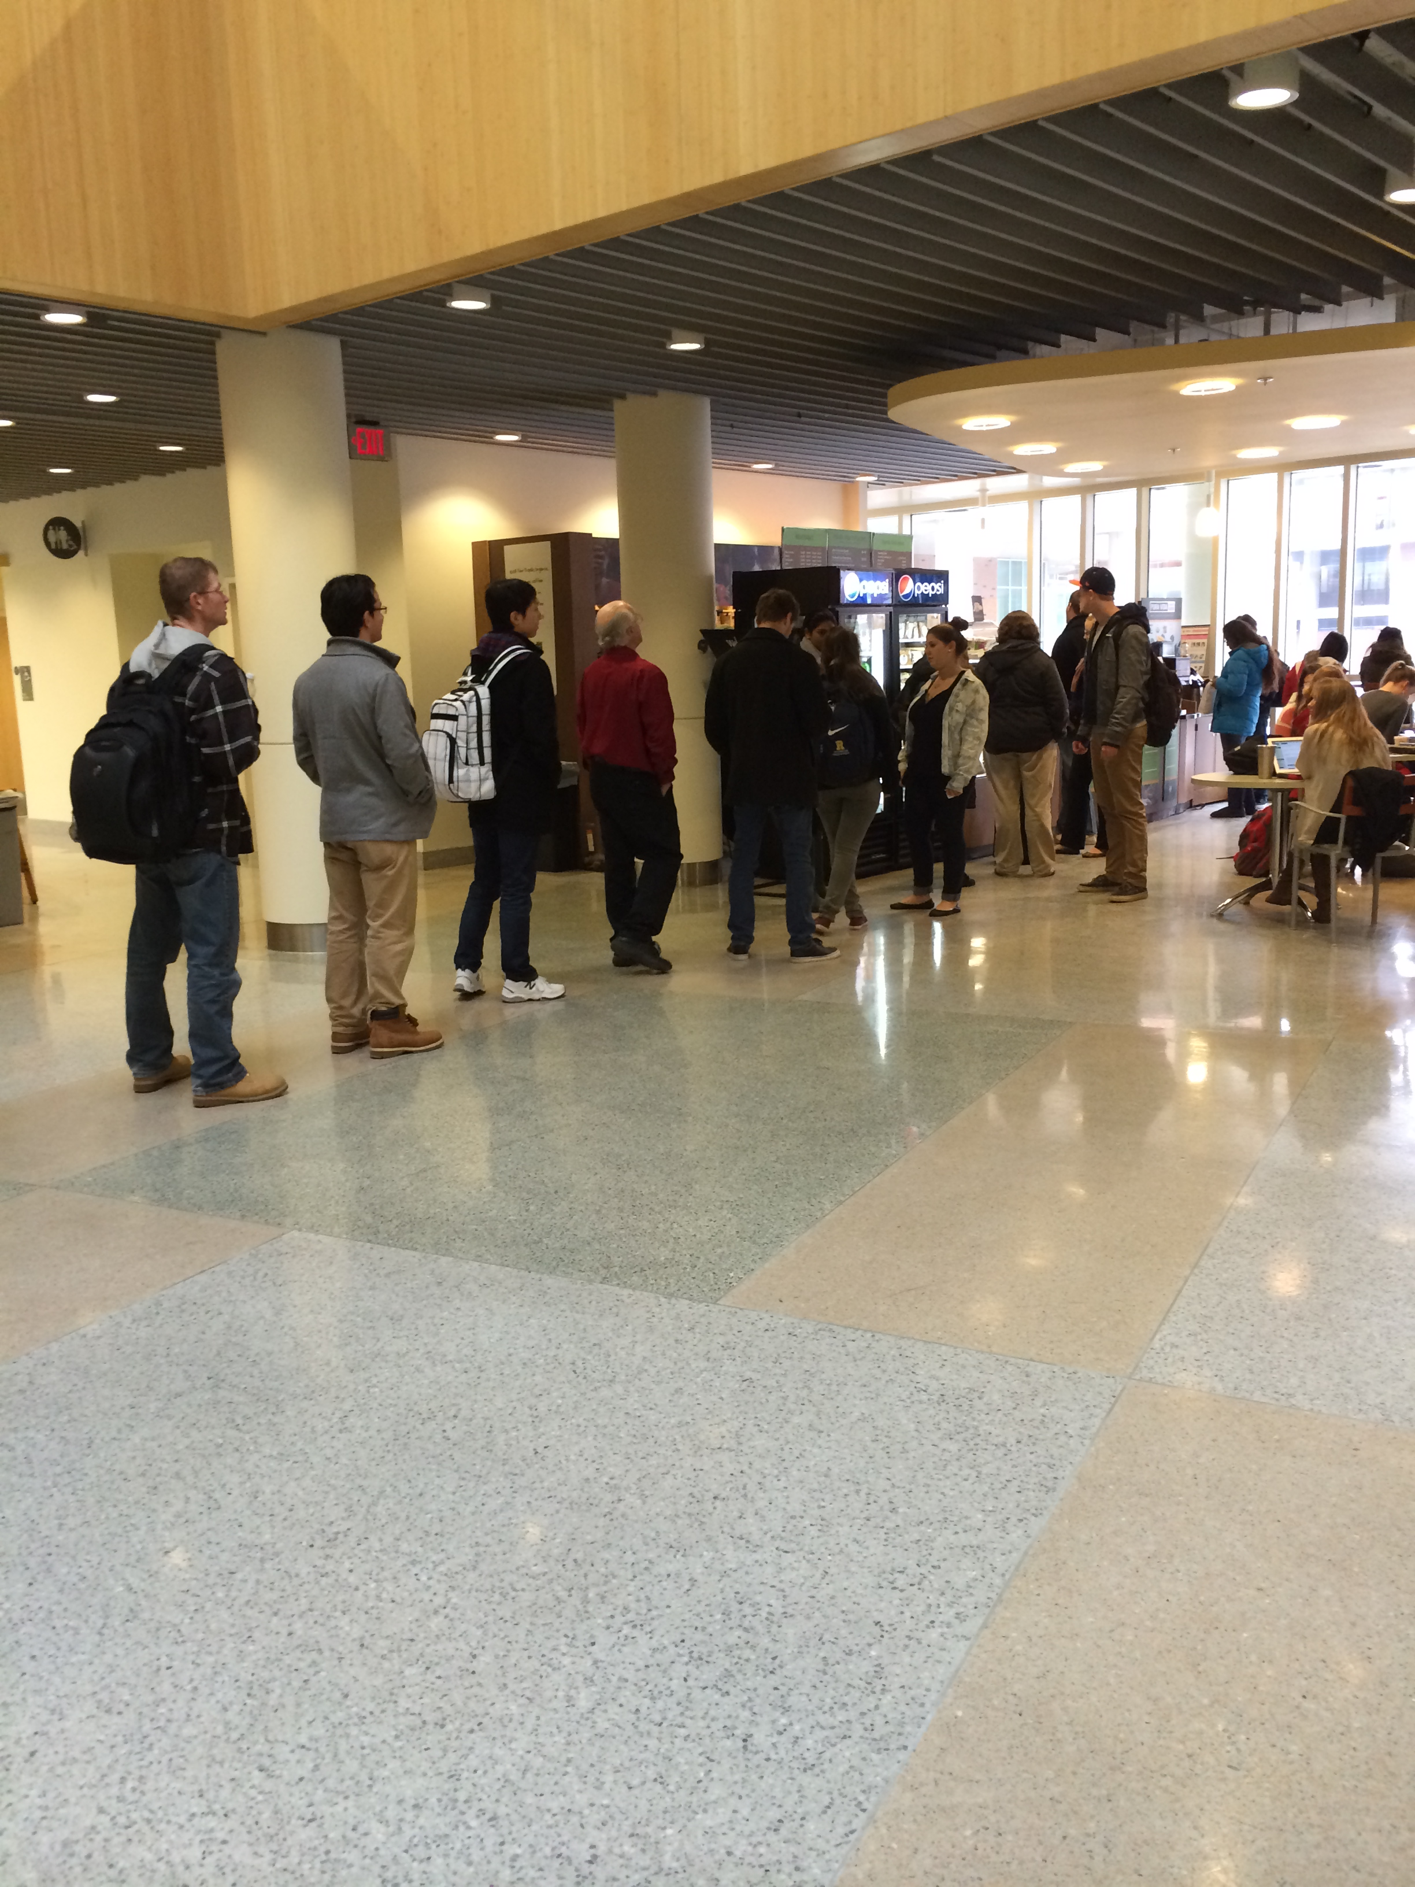
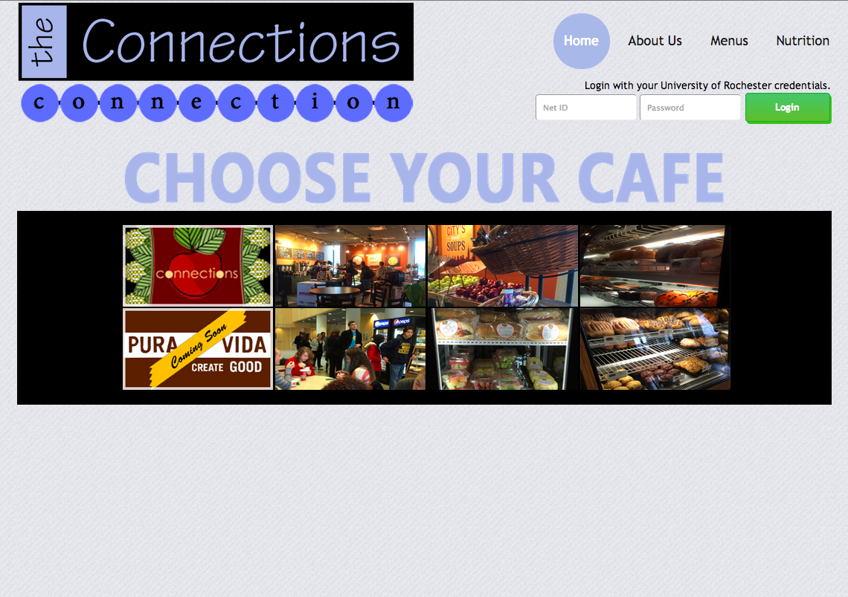
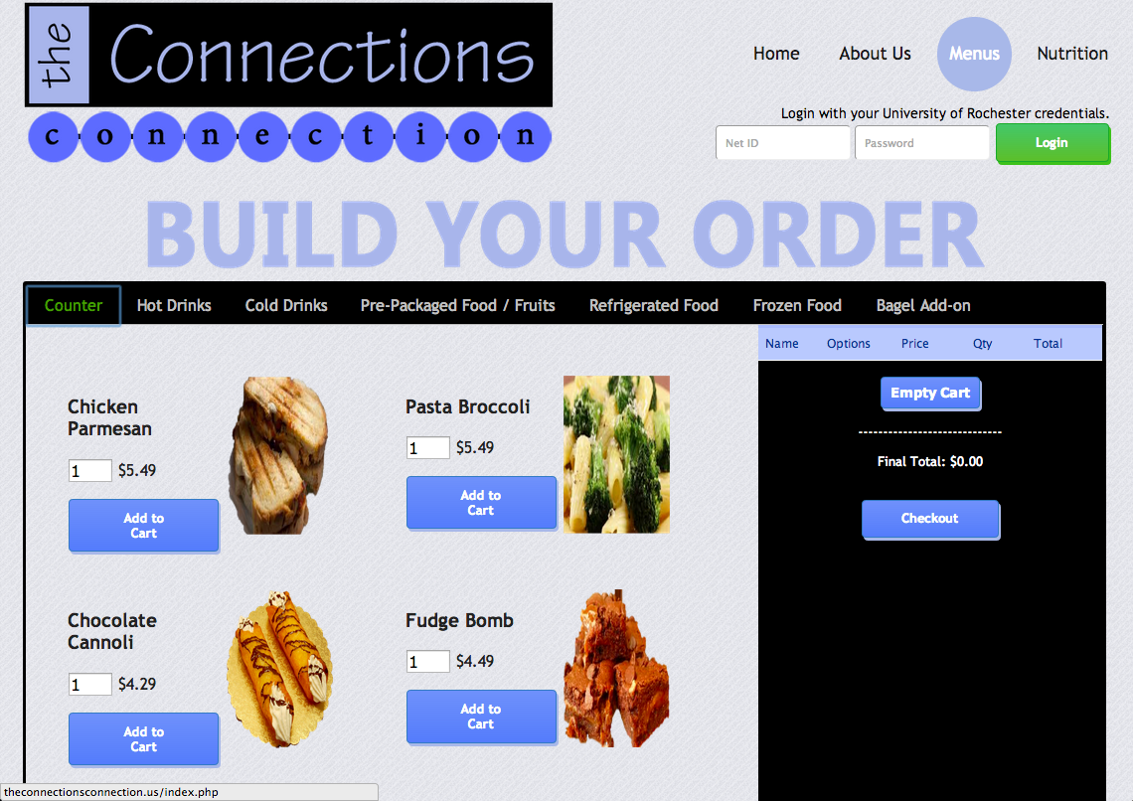
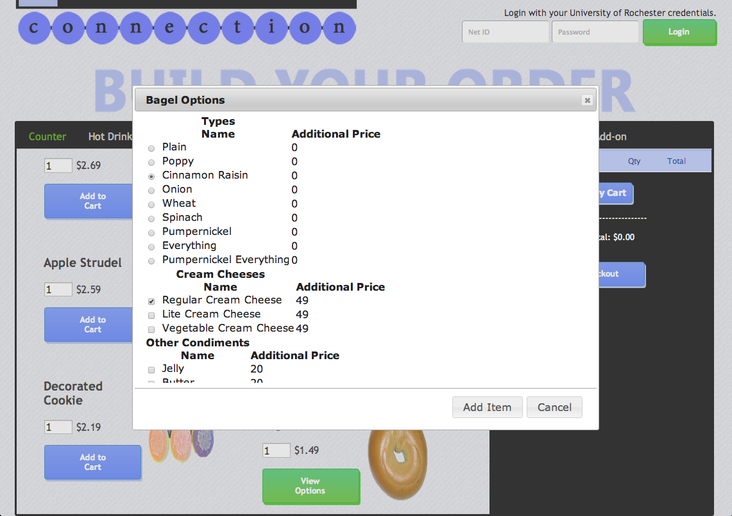
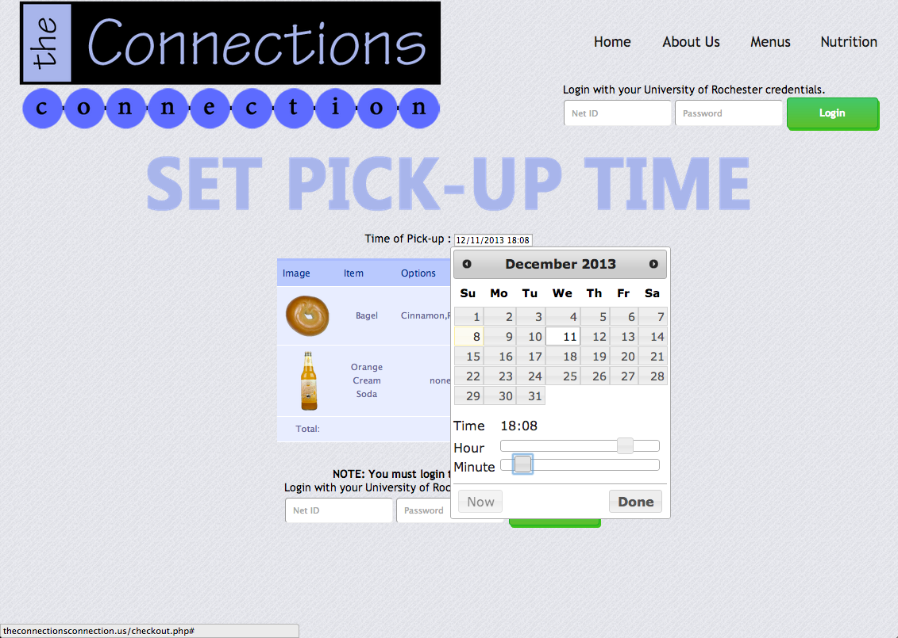


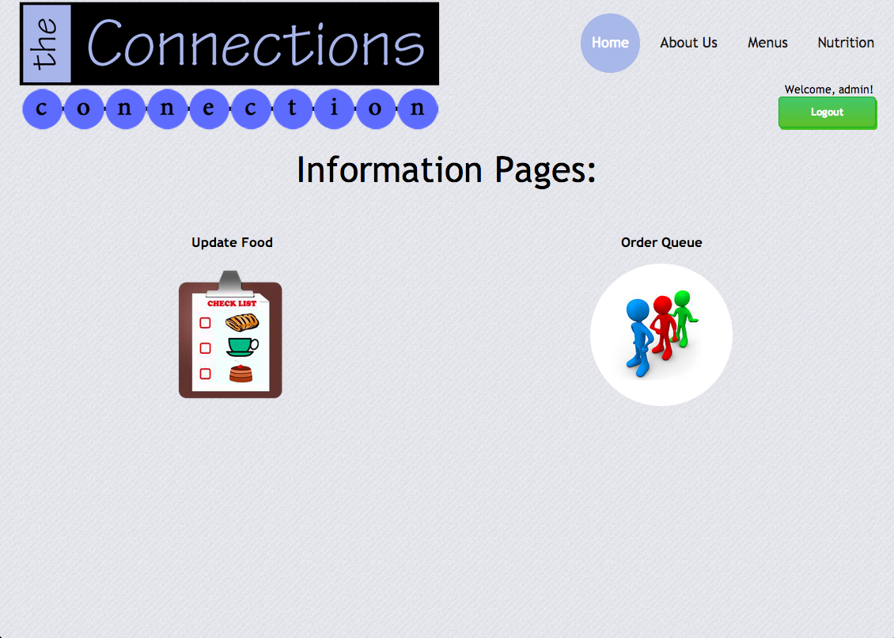
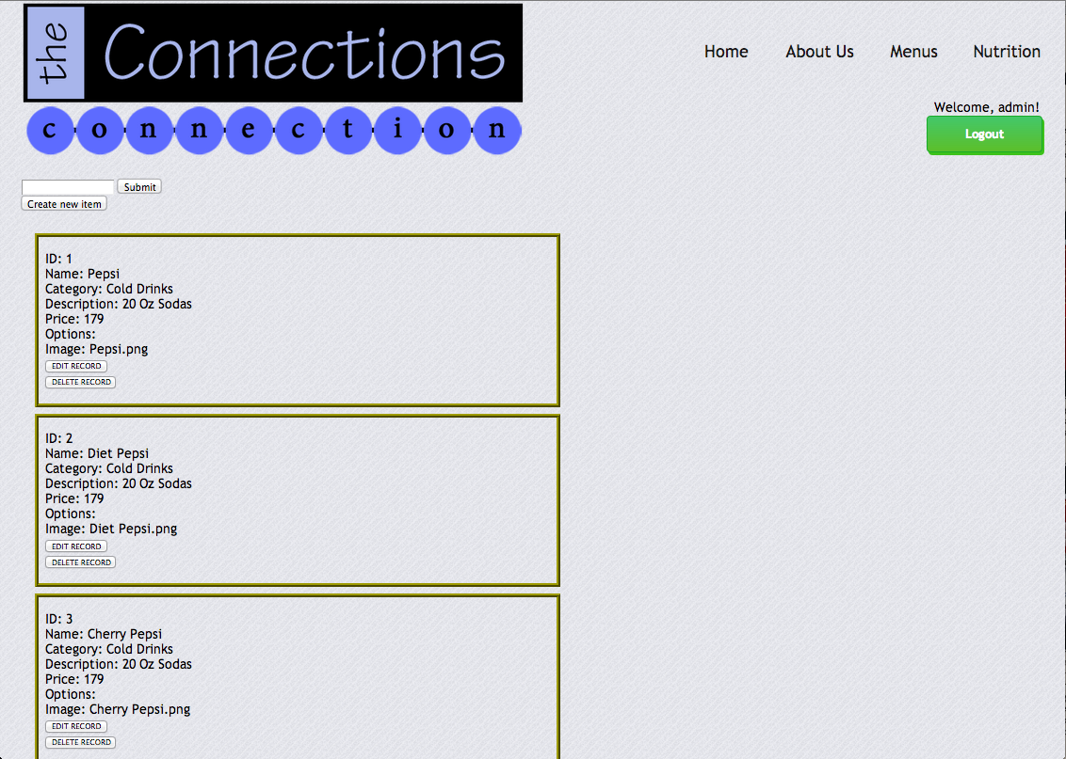
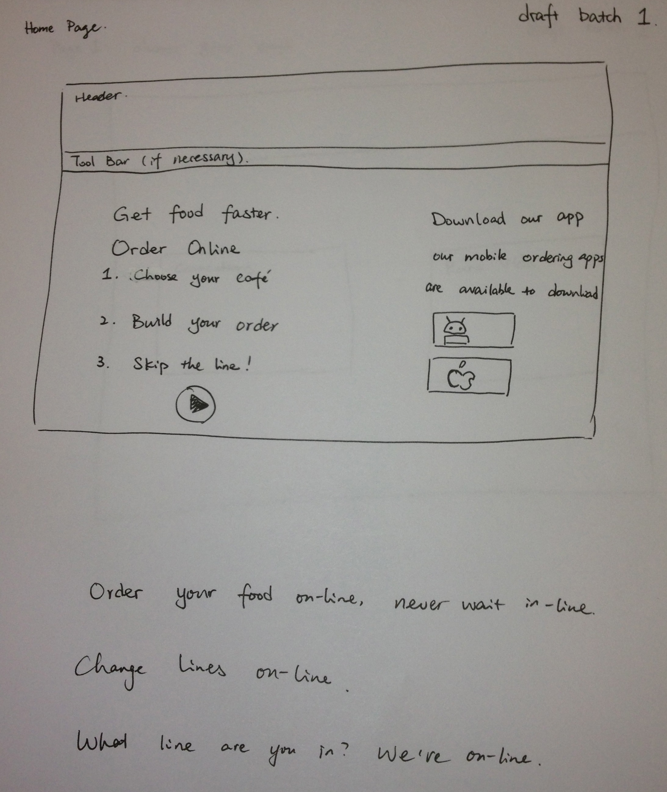
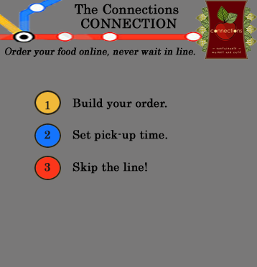
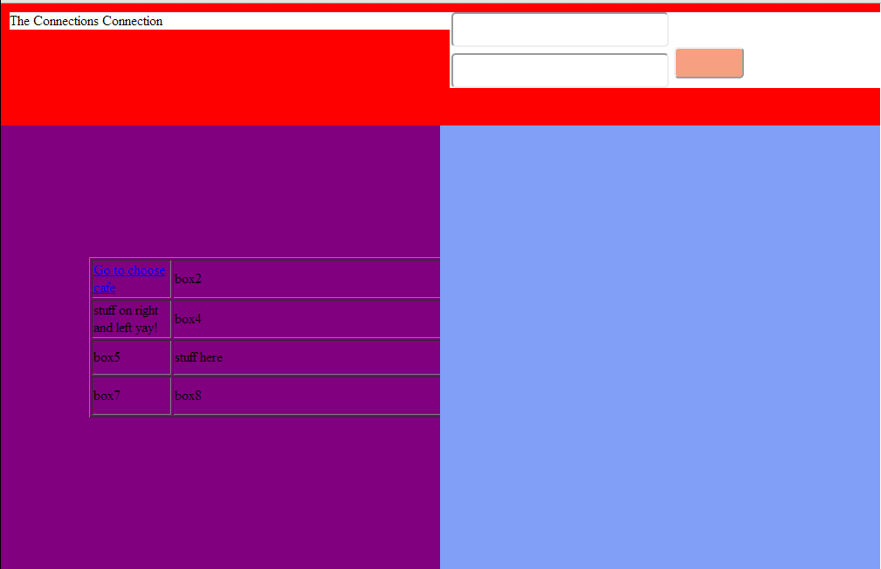
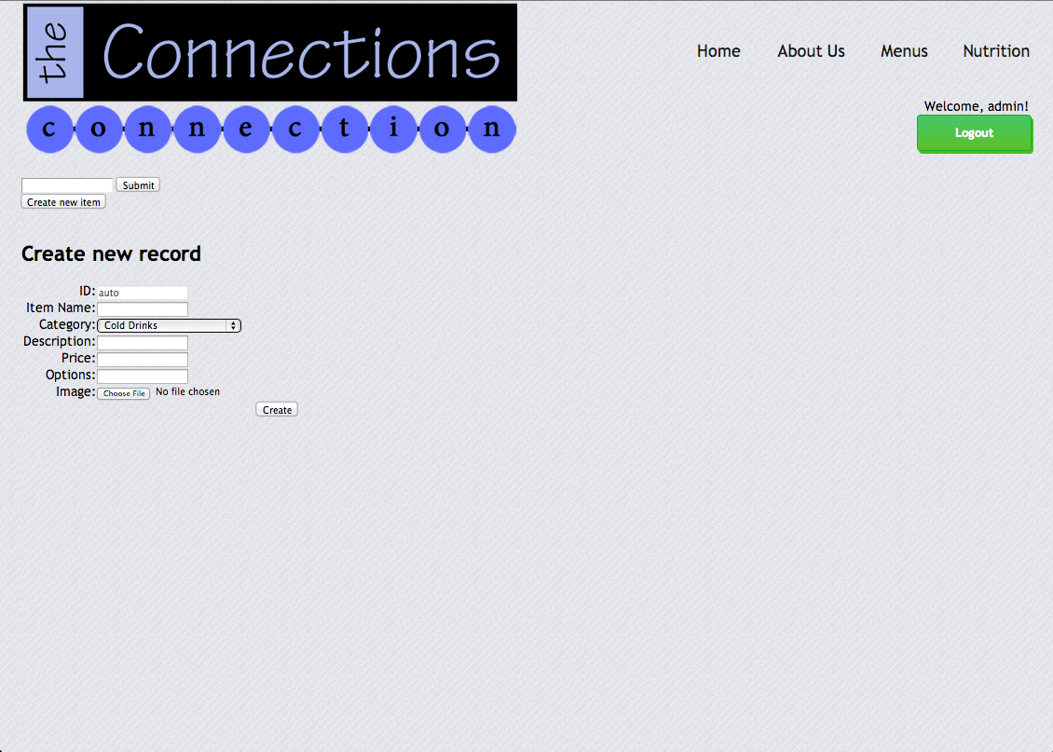
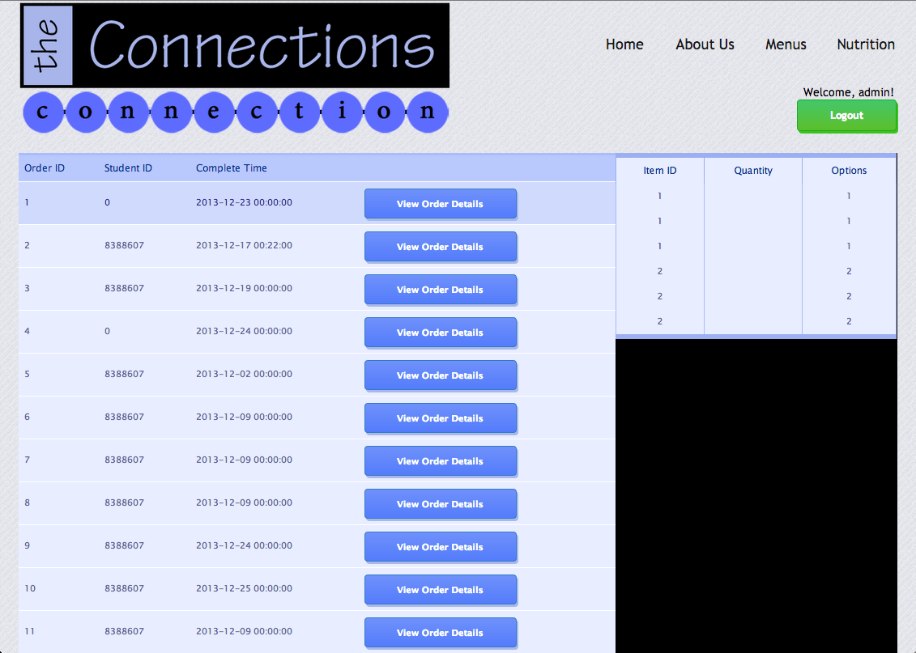
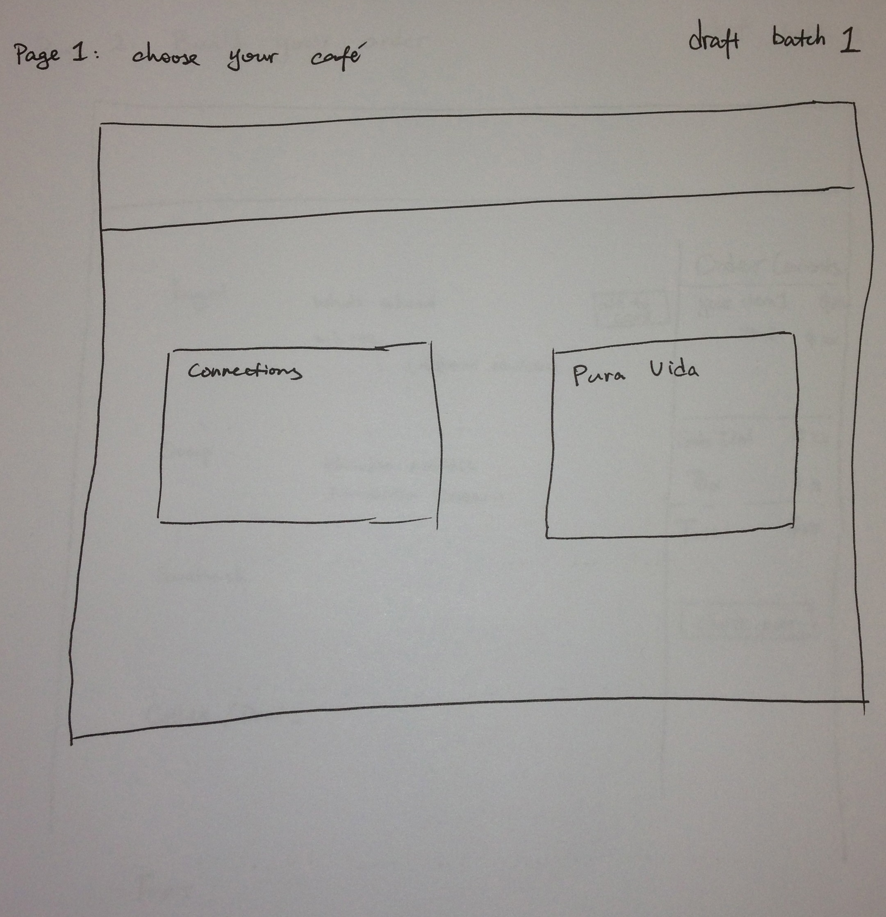
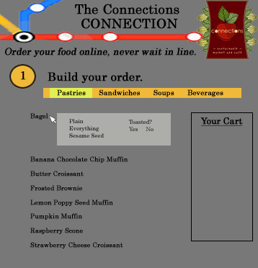
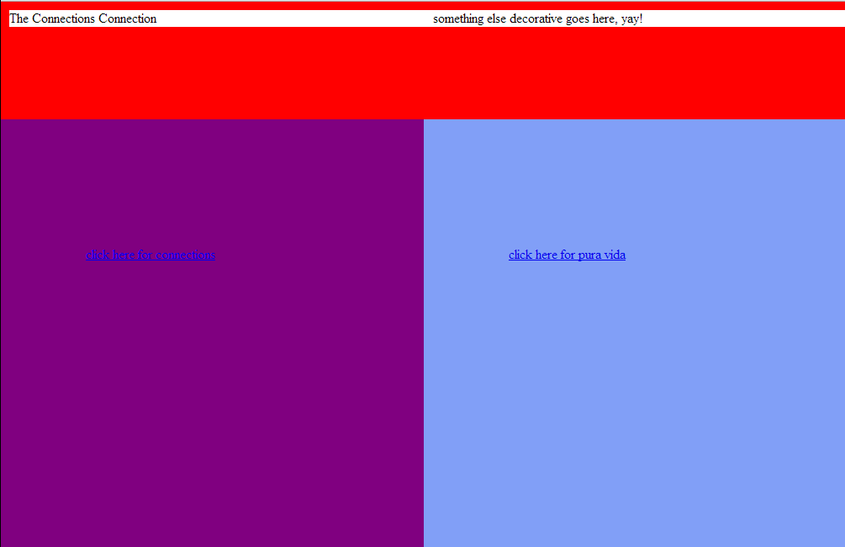
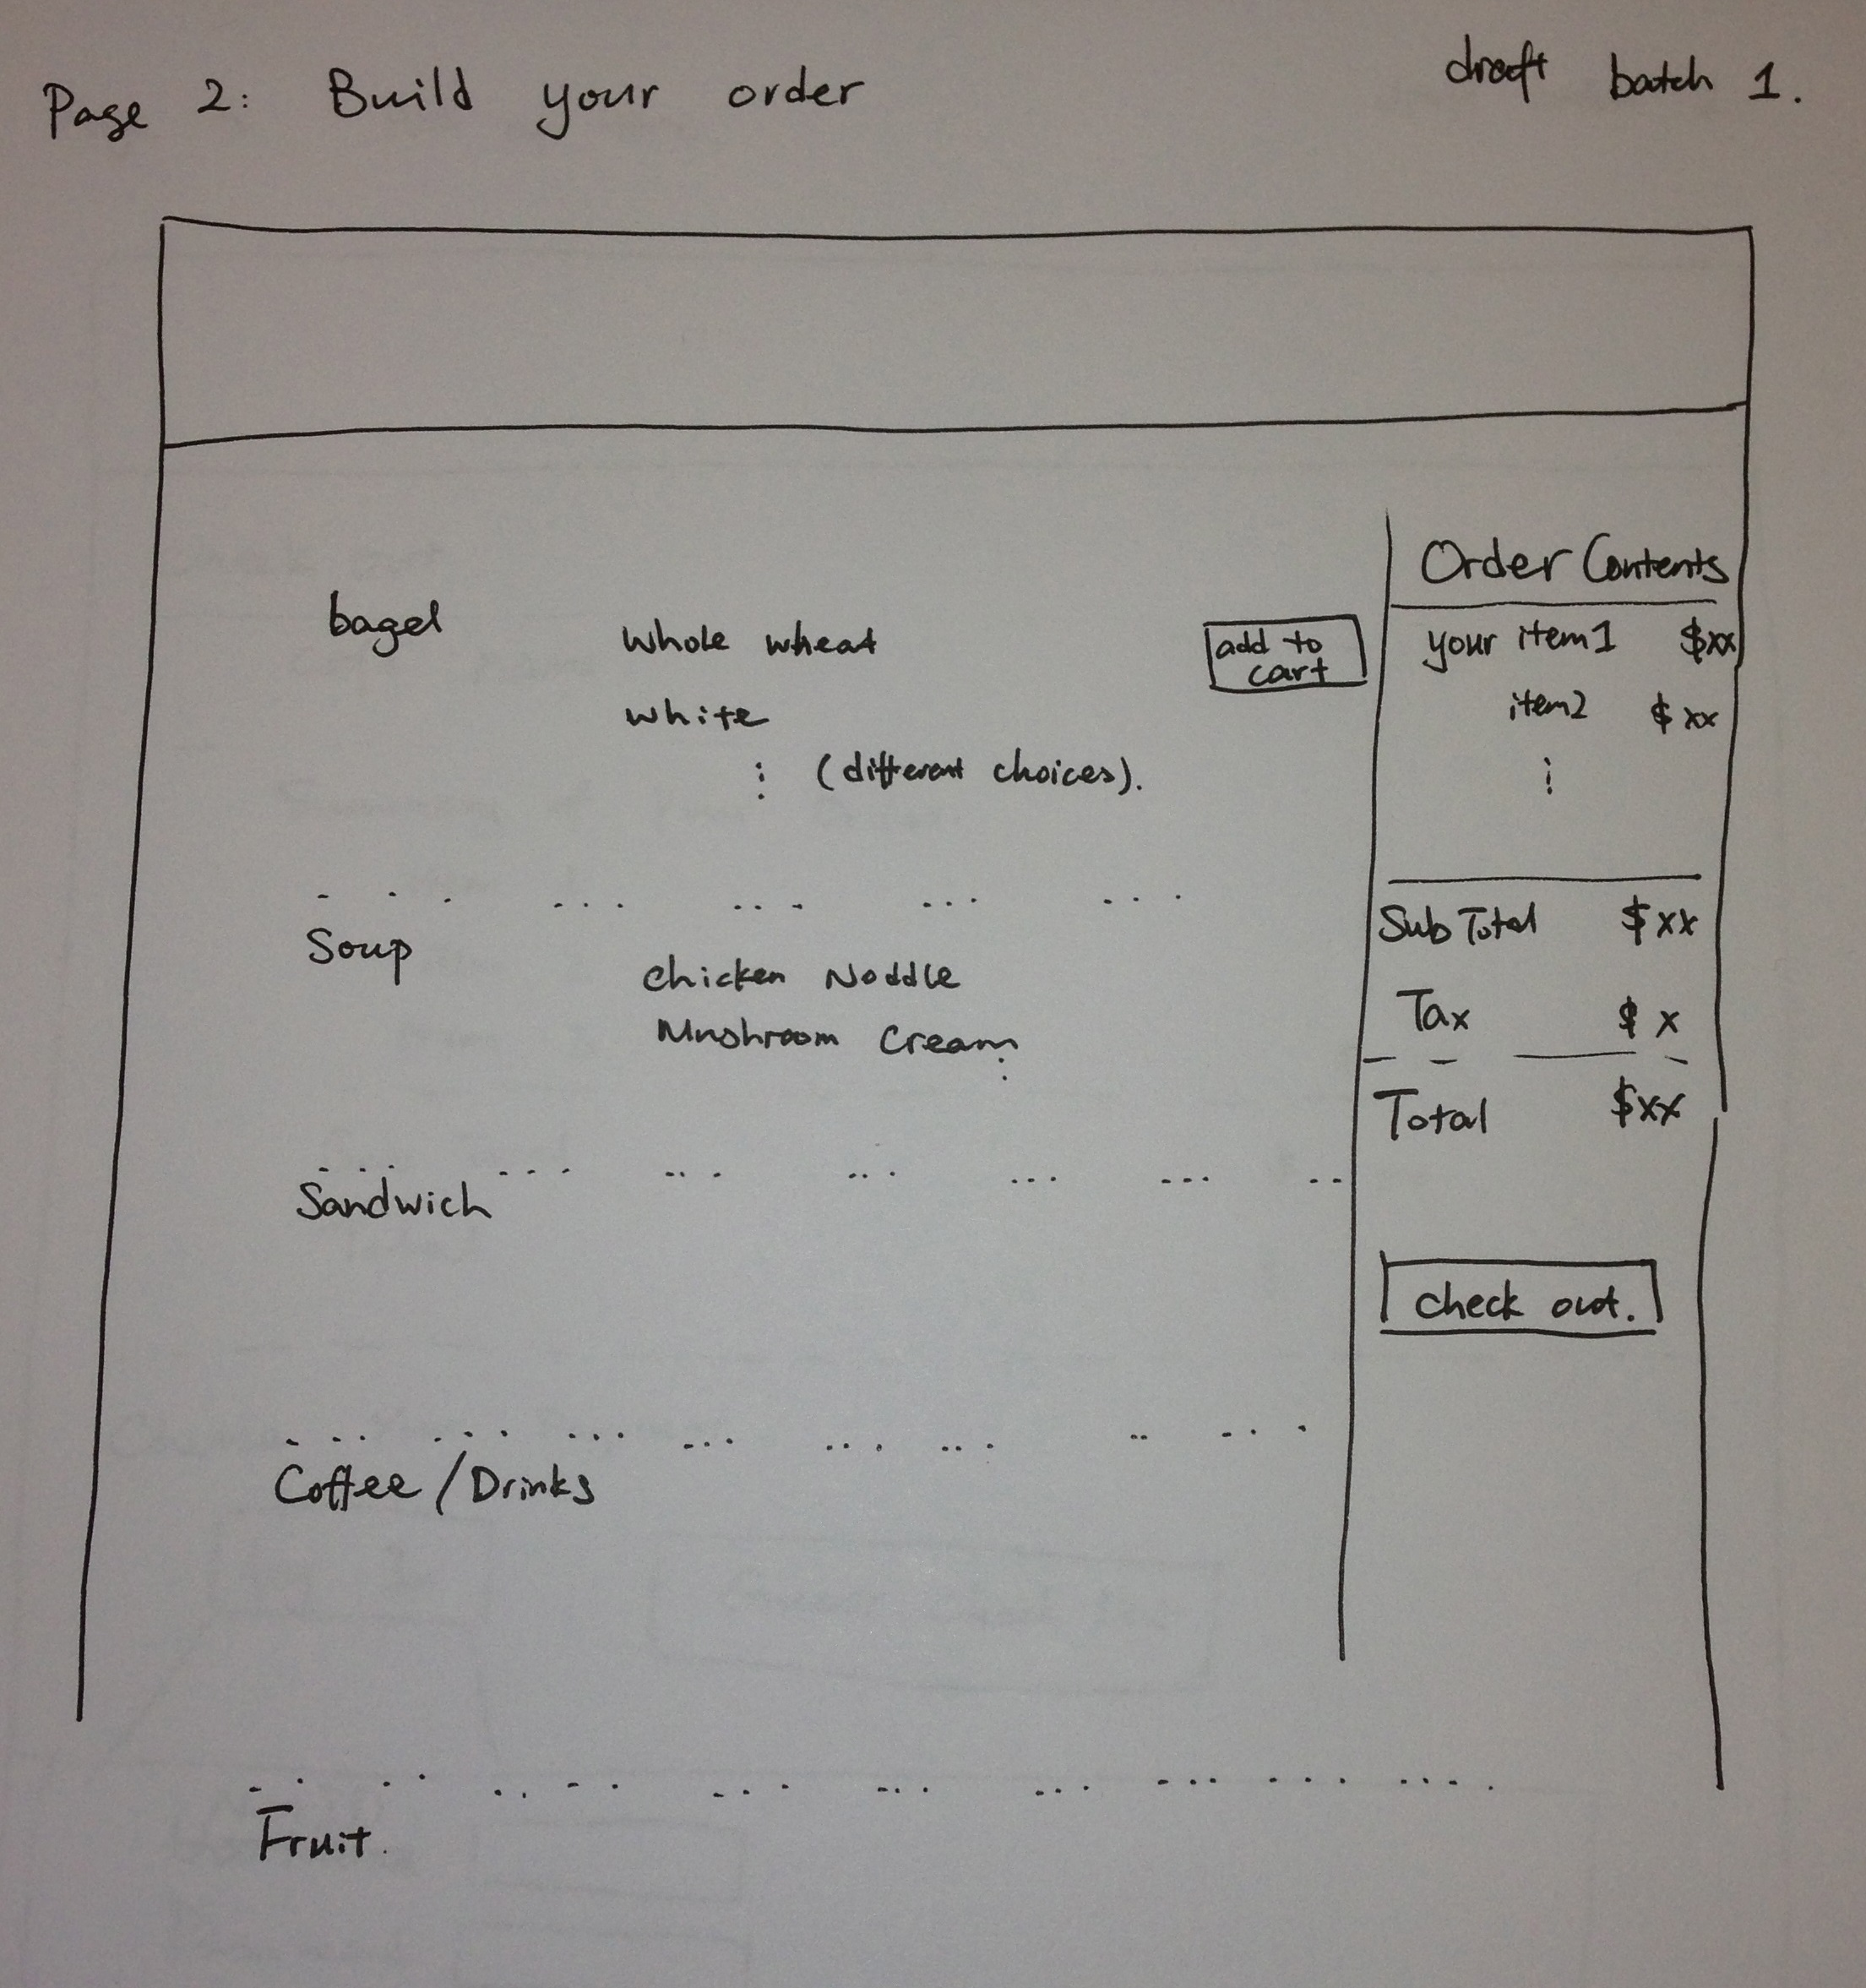
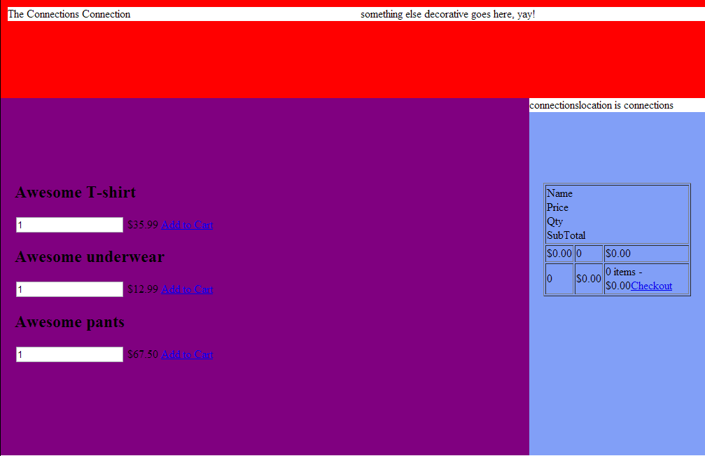
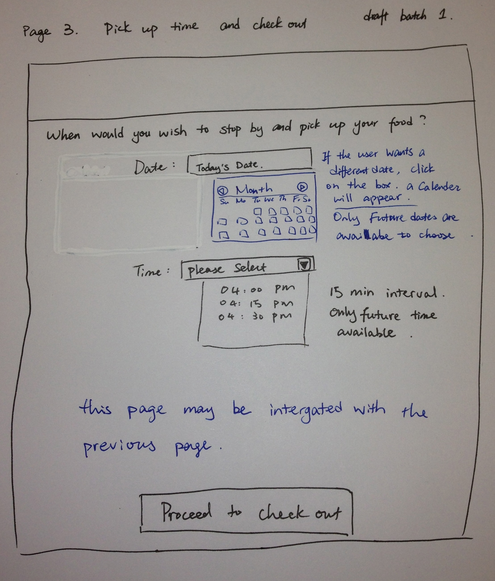
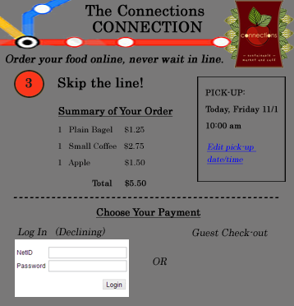
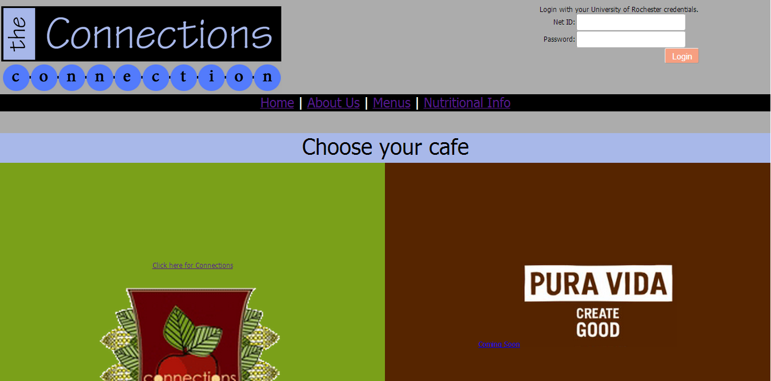
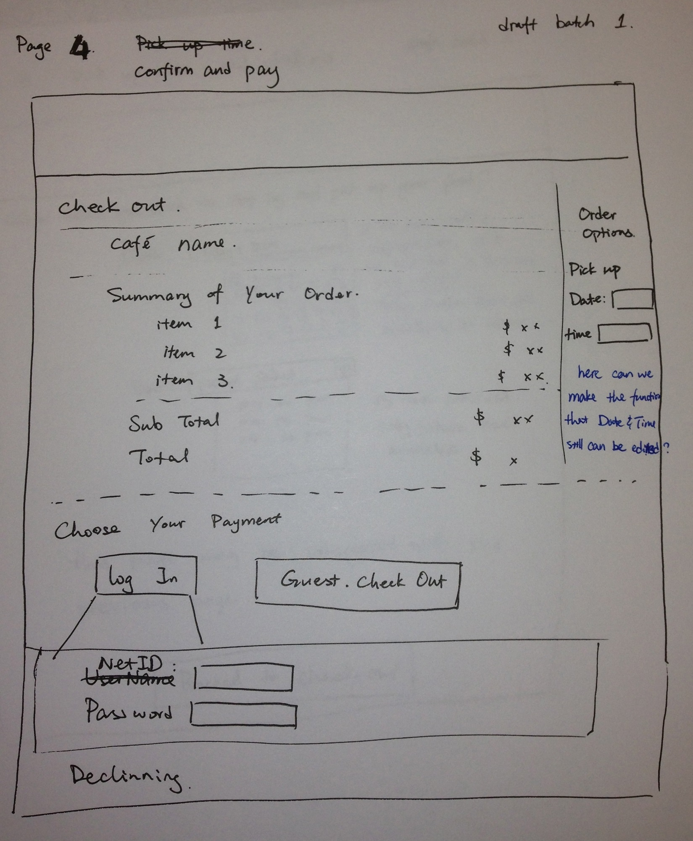
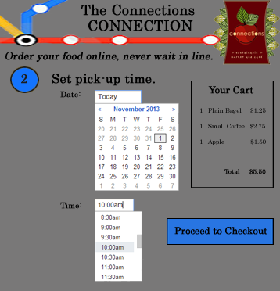
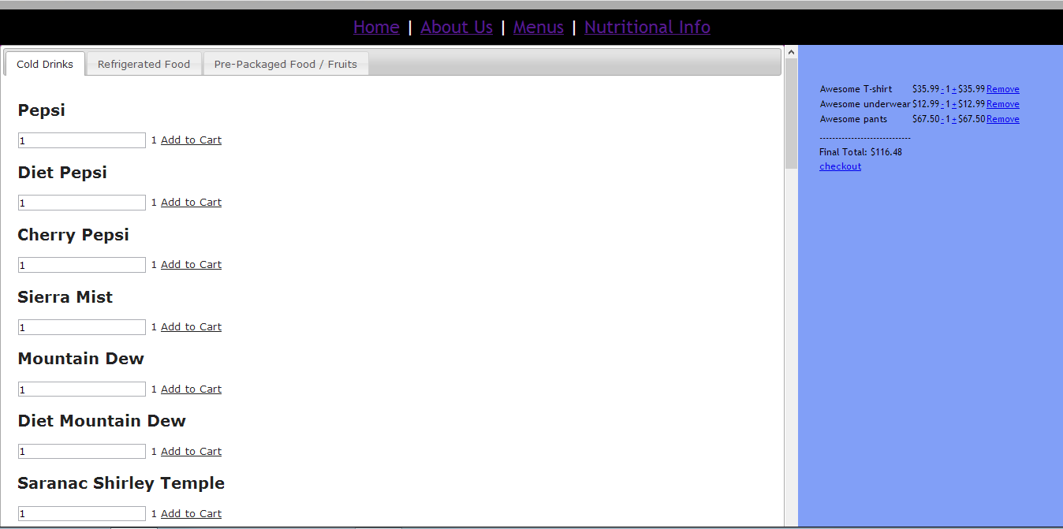
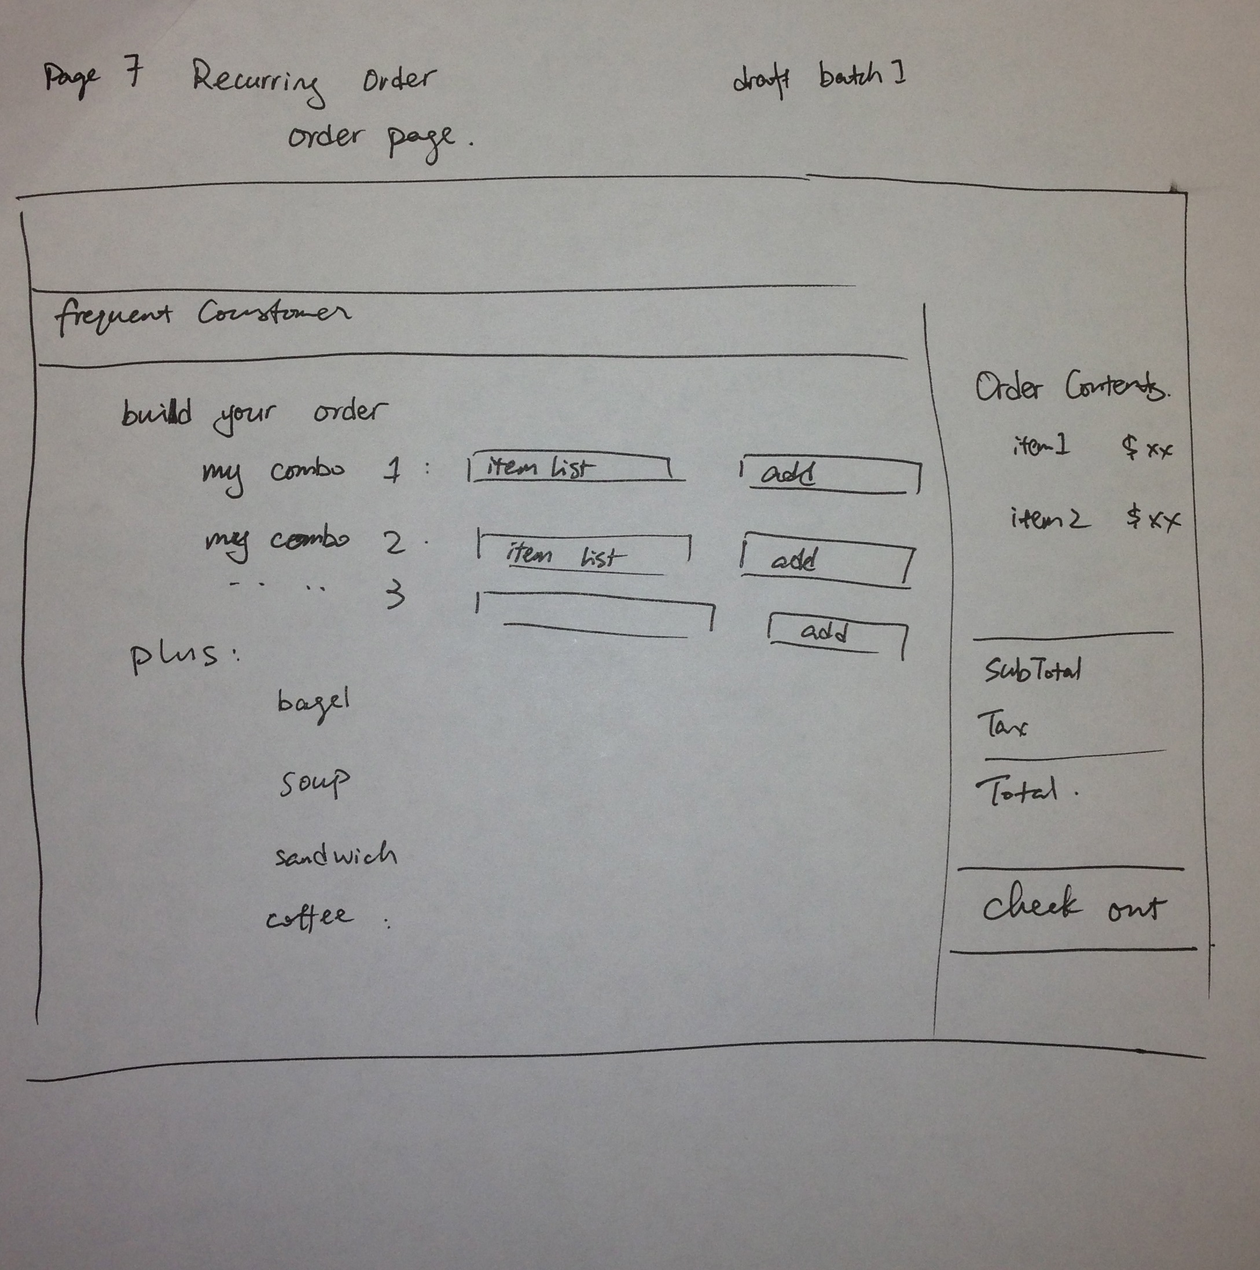
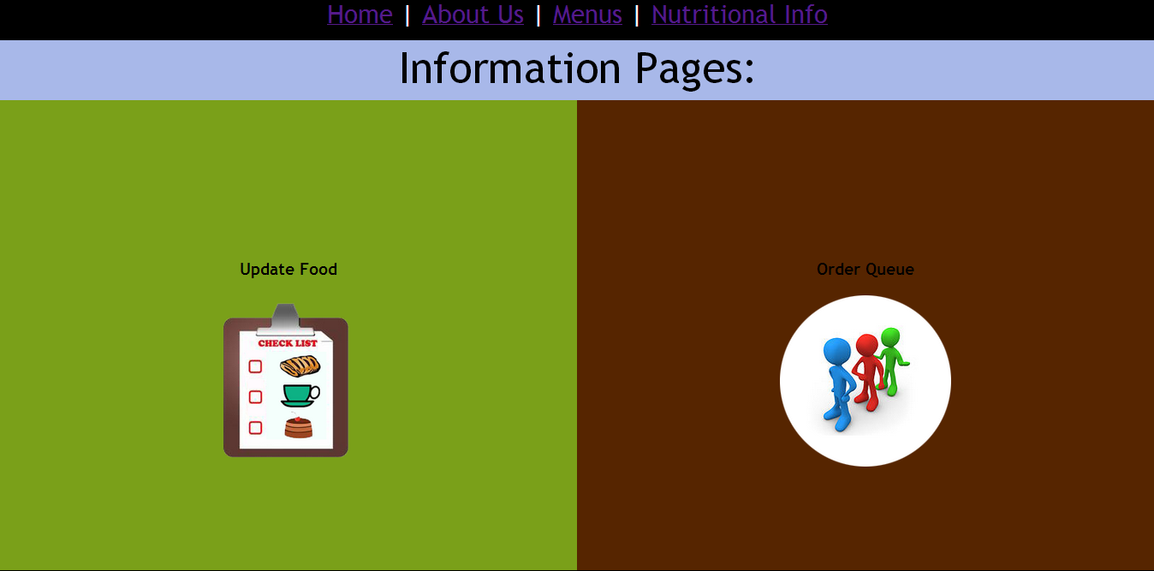
Don’t wait in line, order your food on-line!
The connections connection
Team: Prestige Worldwide
Members: Matt DeMartino, Carolyn Sohmer, Yunping Shao, Zach Taylor, Ted Teumer, Ru Zhao Memtor: Michelle Fung
Need Finding
Features : customer side
How it works
Discovery
We want to get food on campus, but don’t have time to wait in line.
Technologies used: HTML5, HTML, CSS3, PHP, javascript, jQuery, MySQL, AJAX, Long Polling
Database: (I’m not sure about the text on the slides).
Inspiration
Currently many restaurants are allowing customers to order online.
We saw an existing opportunity to introduce an online ordering system to help UR students getting their food faster.
User Evaluation
Pic of user using the website. (screen shot from the vedio)
Evaluation result
Features : administration side
Iterations of Prototypes:
The Future of the project
Smartphone app
Mel to Go, Pura Vida
Geolocation
Recurring Orders
Declining and NetID integration
Notes:
Maybe add some descriptions for features?
Reference: http://hci.stanford.edu/courses/cs247/2012/images/posters/CS147-MealSharePoster.jpg

